Slide 1

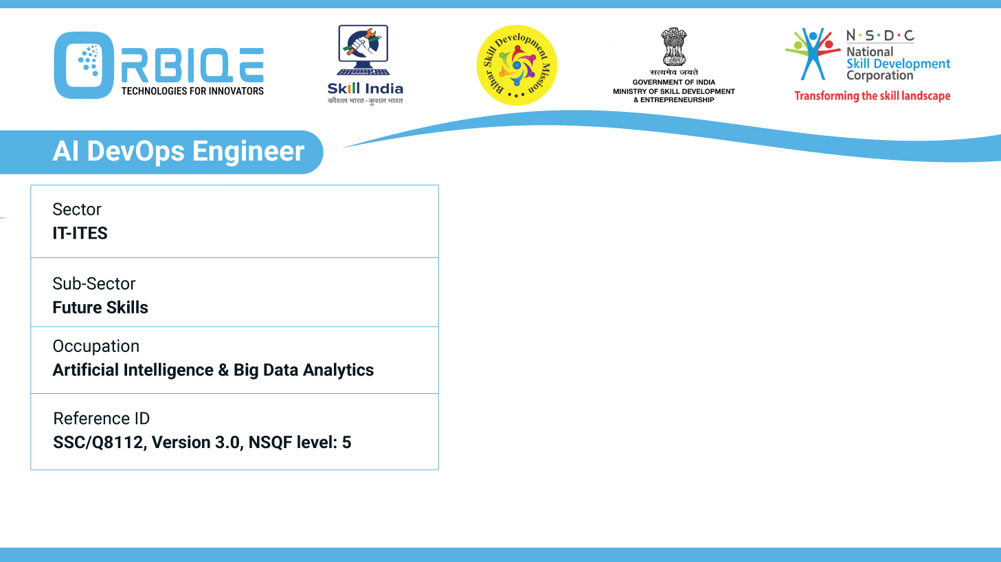
Name- Krishna Kant Dubey

Slide 2

Continuous Integration Tools

Slide 3
Agenda
Integrate version control systems
Automate build processes
Trigger tests
Deploy applications

Slide 4
Integrate version control systems

Slide 5
Automate build processes

Slide 6
Trigger tests

Slide 7
Deploy applications

Slide 8
Thank You

